Slide 1
Group Organizer
Designer and Programer:
Carolus Magnus X Theel

Slide 2
Ideas for Mr. Brown
A Group Organizer (Chosen)
Pepper Paper Party Point/ Mistake Tracker
A tutoring app

Slide 3
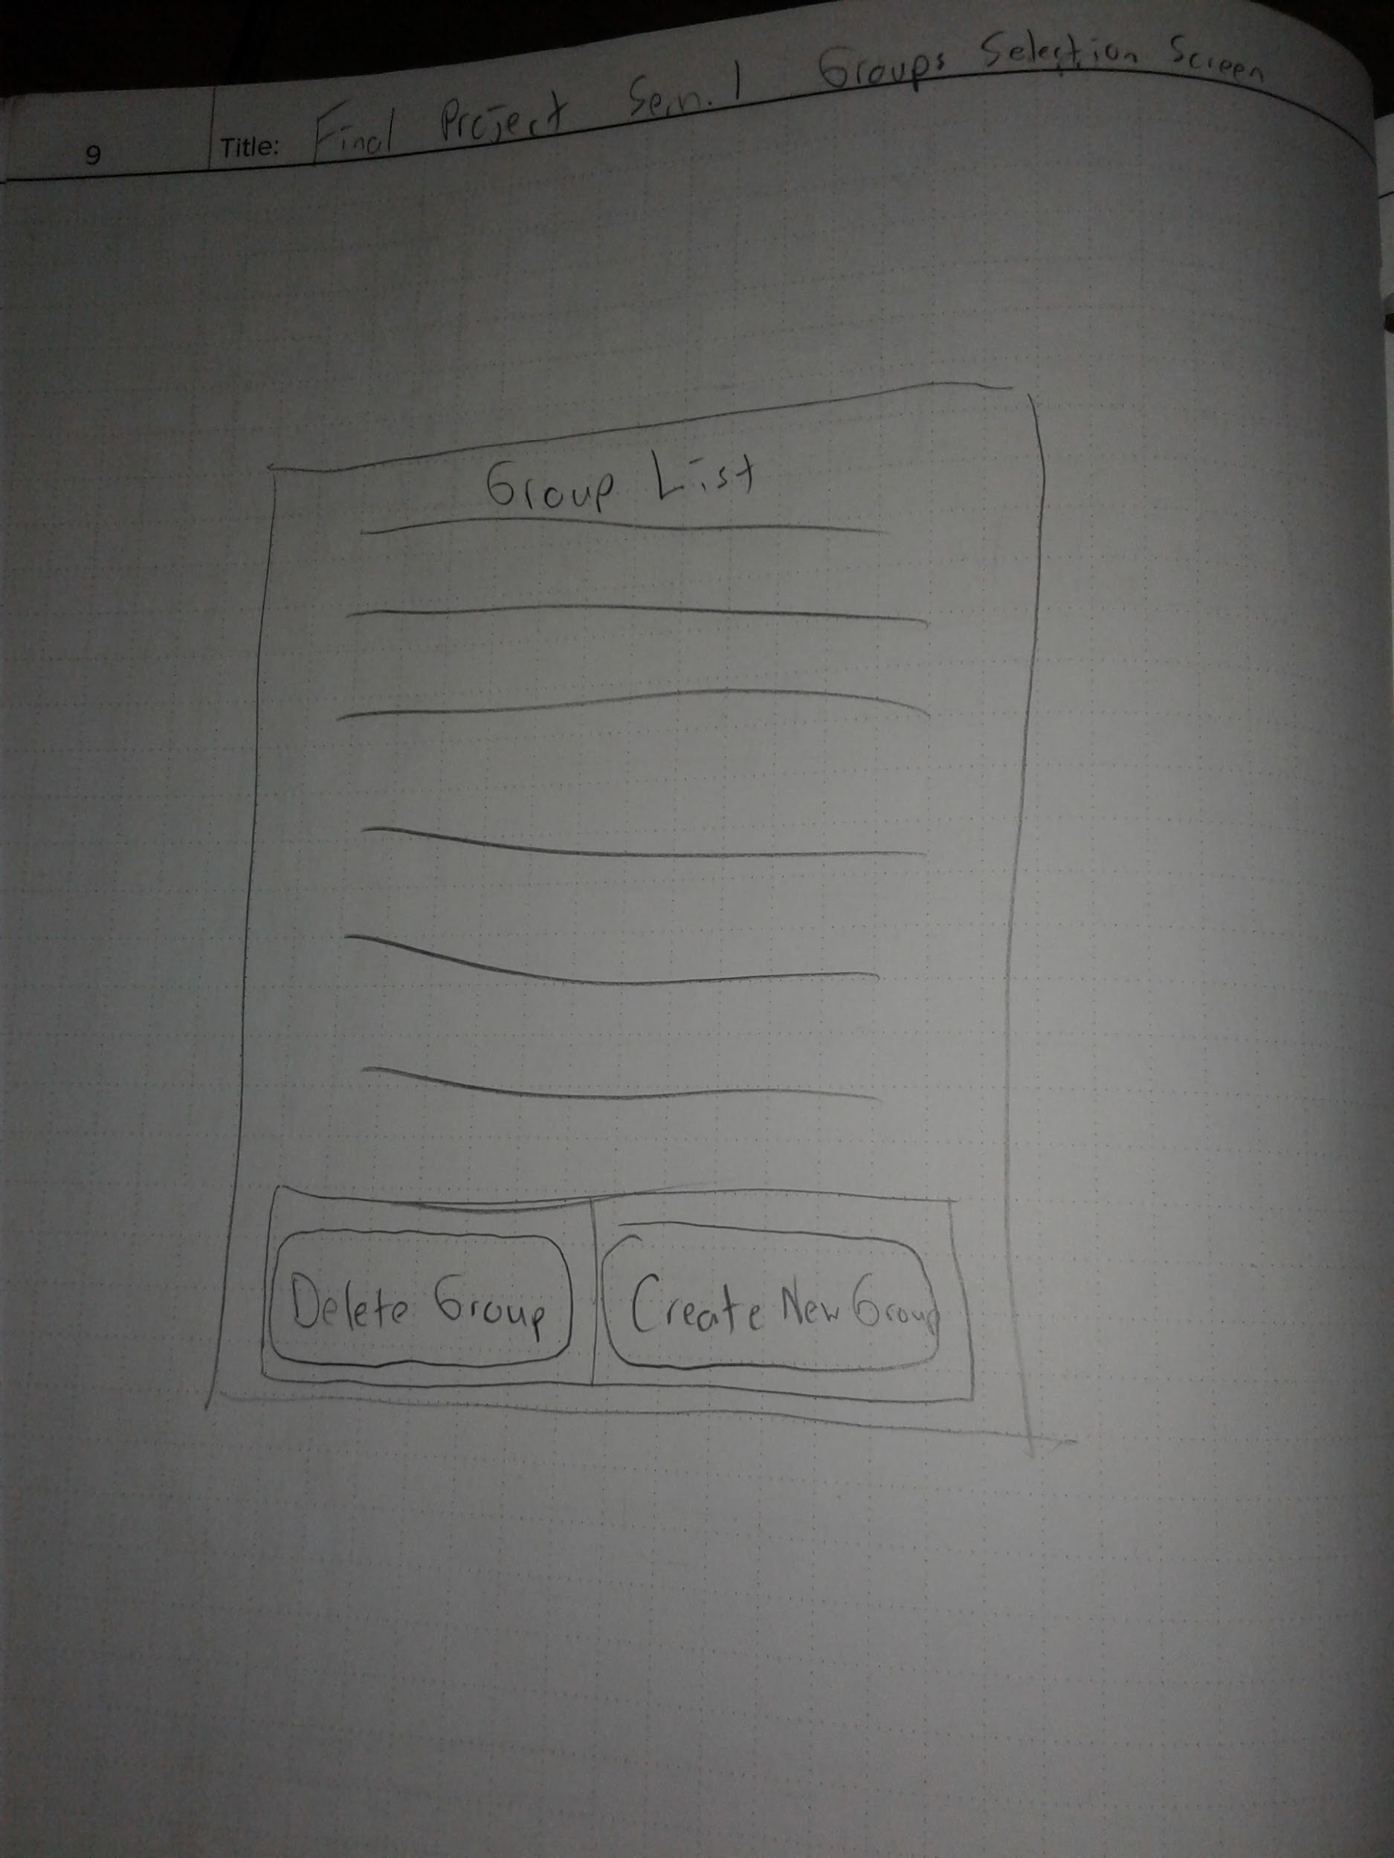
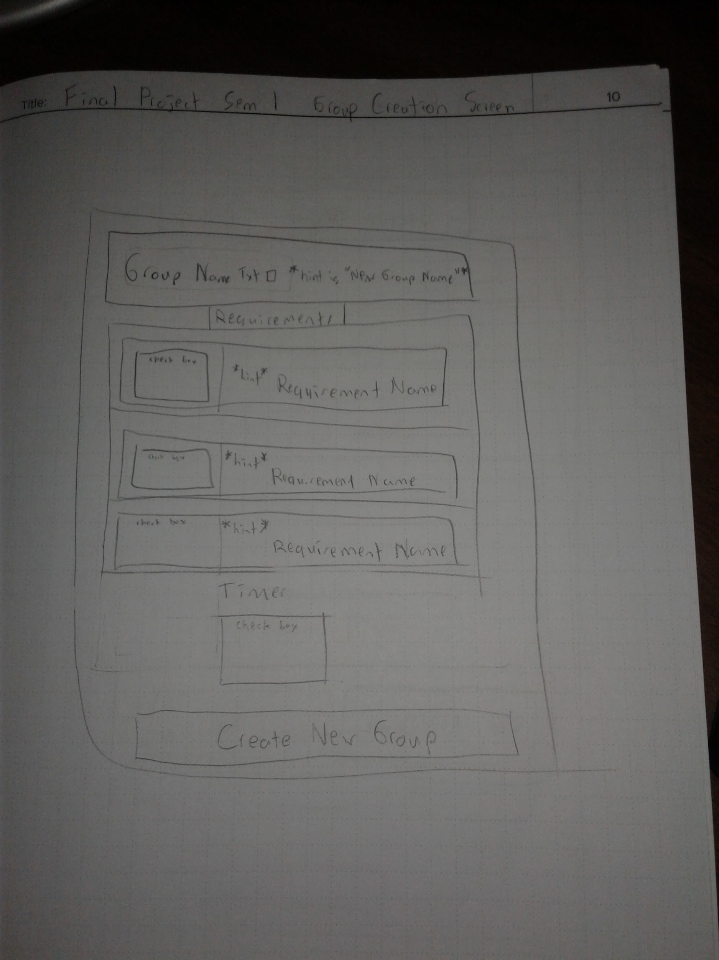
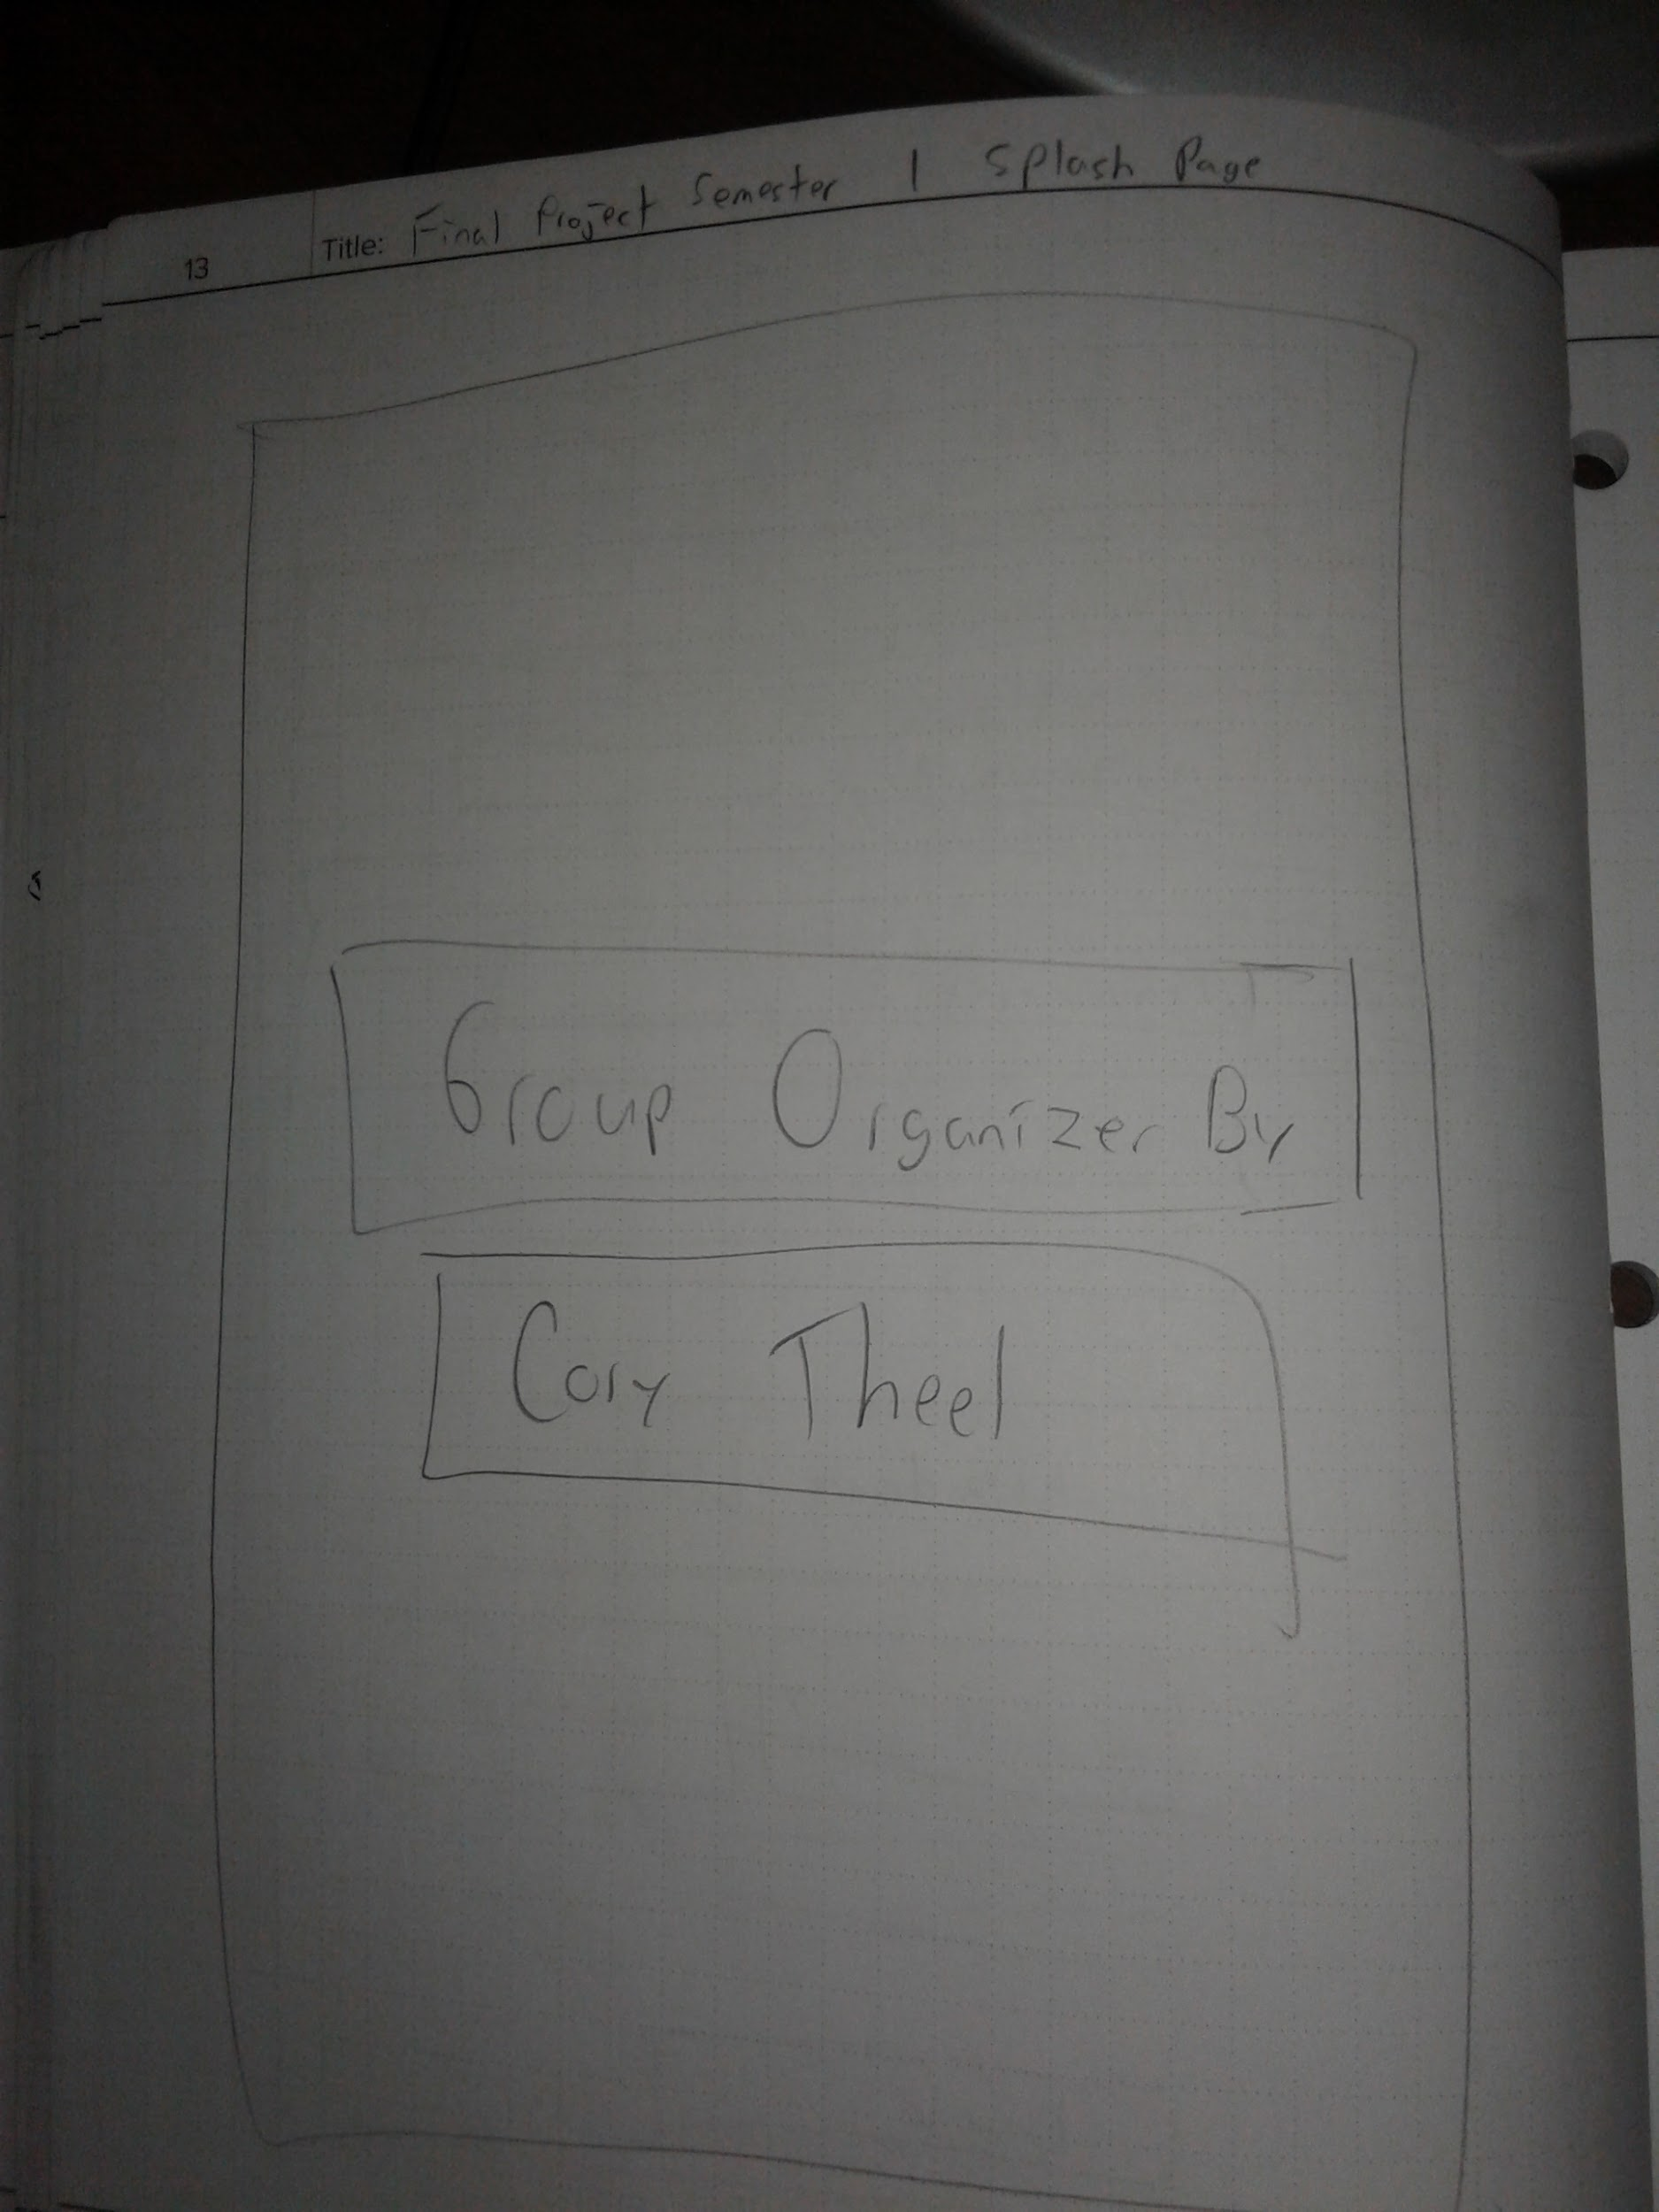
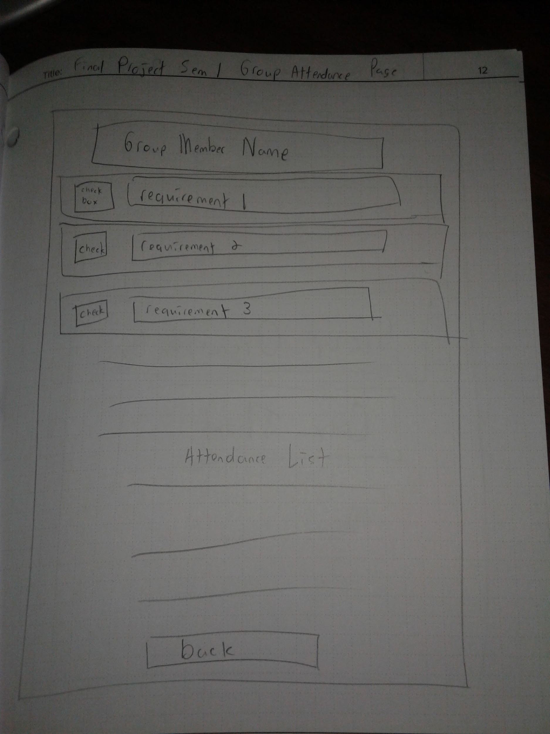
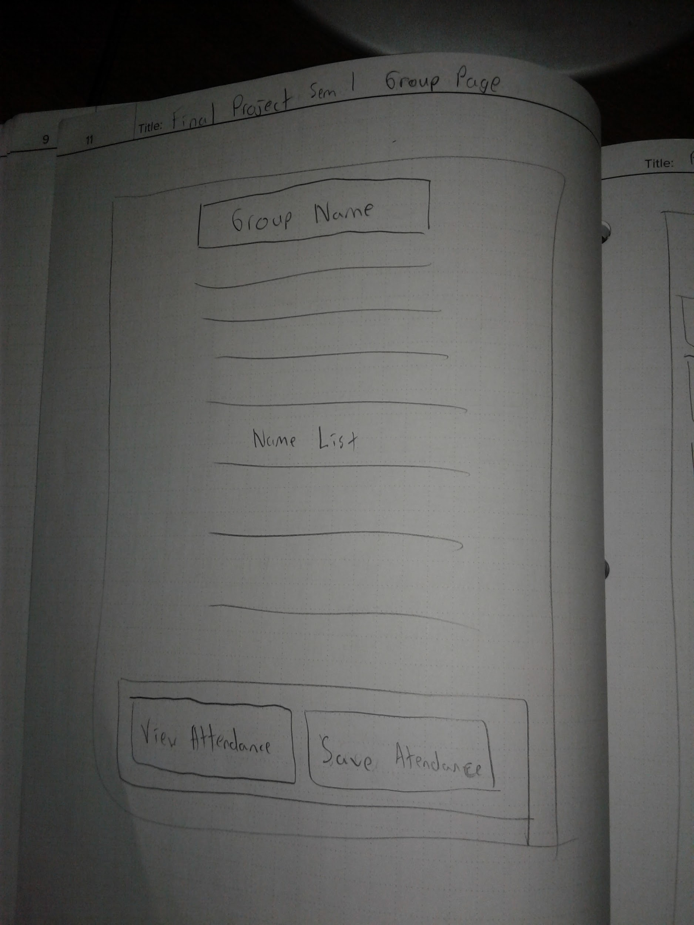
Screen Sketches

Slide 4
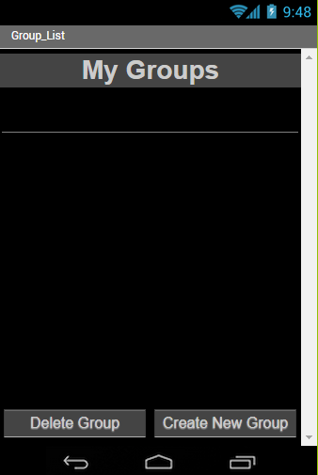
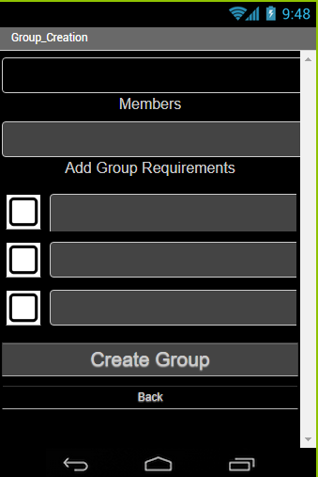
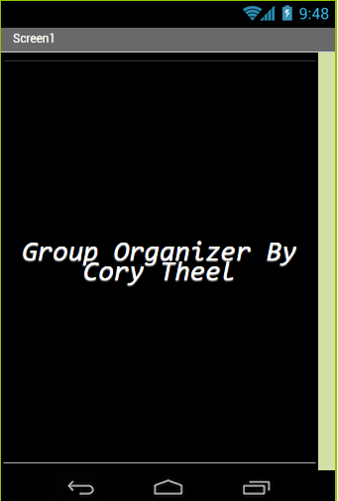
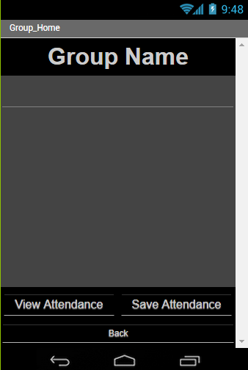
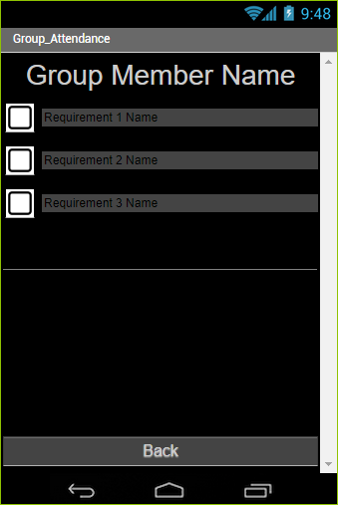
Completed Screens

Slide 5
User Stories
User can view all of their
groups on the group page
User can view a specific group
by pressing the groups name
User can create a new group
by pressing "create new group"
button
User can add up to 3 requirement boxes
by pressing the checkbox, and naming
them
User can add members to a group by typing them
into a text box, separating each name
with a comma
User can show that people attended
a meeting by tapping their finger on
the person's name
User can view how many times someone
has attended meetings by pressing the
"view attendance" button
When user presses "Save Attendance"
button, they will be asked to input date
User can view the group page by
pressing the back arrow button on their
device in the attendance page
That I completed....

Slide 6
User Stories
User can add timer by checking the
"add timer" box
User can start a timer on someone
by tapping their name
When user marks someone present, name
will turn green.
User can view how many times someone
has attended meetings by pressing the
"view attendance" button
User can view timer by pressing view
times button
User can view the group page by
pressing the back arrow button on their
device in the attendance page
That I have yet to complete...

Slide 7
Sprint Calendar
Monday Nov 13 User can view all of their groups on the group page User can view a specific group by pressing the groups name | Wednesday Nov 15 User can create a new group by pressing "create new group" Button User can name 3 requirement that will be used in that group | Friday Nov 16 User can add timer by checking the "add timer" box User can delete a group by pressing “Delete Group” button and then pressing the group they would like to delete
Monday Nov 27 User can add names by typing them into a text box, separating each name with a comma | Wednesday Nov 29 User can start a timer on someone by tapping their name User can show that people attended a meeting by holding their finger on the person's name | Friday Dec 1 User can show that people attended a meeting by holding their finger on the person's name When user presses "save attendance" button, attendance information will be saved
Monday Dec 4 User can view how many times someone has attended meetings by pressing the "view attendance" button User can view timer by pressing view times button | Wednesday Dec 6 User can take picture of person when creating a group, by pressing the "Add Picture" button When user presses "Save Attendance" button, they will be asked to input date | Friday Dec 8 User can view the group page by pressing the back arrow button on their device in the attendance page

Slide 8
Challenges
The organization of data in tiny databases
Being able to save data that did not overlap if 2 people from different groups had the same name
The “requirements” in the attendance page

Slide 9
Successes and Failure
Successes
App can hold information on members and requirements
Mr. Brown liked it
----------------------------------------------
Failures
Cannot store attendance information
Timer does not work (was removed in final app)

